Slide 1
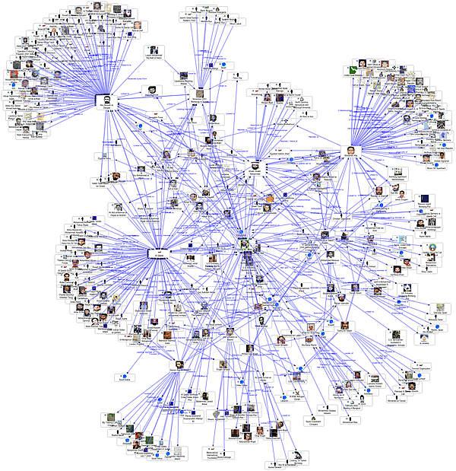
The role of developing nation towards combating cyber warfare: An insight on the social network behind a terrorist attack
Fourth International Forum “Partnership of State Authorities, Civil Society and the Business Community in Ensuring Information Security and Combating Terrorism”
April 12–15, 2010, Garmisch-Partenkirchen, Munich, Germany
By: Dr. Abhishek Vaish

Slide 2
OVERVIEW OF THE size Indian IcT Market
The expected size of the world wide IT Service market is some where around UD$ 60 Million in exports.
The total market representing of the Indian IT market is closed to 48 million UD$48 including domestic and exports an increase of 28 % from the last year.
Size of Indian telecom industry likely to reach $878.12 billion by 2012. Source Indian Telecommunication dept.
81,000,000 Internet users as of Nov/08, 7.0% penetration, per ITU.
5,280,000 broadband Internet connections as of June/09, per TRAI.

Slide 3
Statistics by NASSCOM

Slide 4
Transition of the security market
Controlling the social network
Development of tools to ensure integrity and stability of system, platform
Security Service market to ensure the privacy and data security of the indiviual
Tools to understand the relationship behind the social network and E- Network
Controlling the data: Secure platform for ensure the flow of the information
Controlling the platform: to ensure the flow of the information

Slide 5
Exploring the network

Slide 6
Hi-Tech Terrorism – Global Presence
From the Middle East
Hamas (the Islamic Resistance Movement)
Lebanese Hezbollah (Party of God)
Al Aqsa Martyrs Brigades
Fatah Tanzim
Popular Front for the Liberation of Palestine (PFLP)
Palestinian Islamic Jihad
Kahane Lives movement
People’s Mujahedin of Iran (PMOI—Mujahedin-e Khalq)
Kurdish Workers’ Party (PKK)
Turkish-based Popular Democratic Liberation Front Party (DHKP/C)
Great East Islamic Raiders Front (IBDA-C)
From Europe
Basque ETA movement
Armata Corsa (the Corsican Army)
Irish Republican Army (IRA)
From Latin America,
Peru’s Tupak-Amaru (MRTA) and Shining Path (Sendero Luminoso)
Colombian National Liberation Army (ELN-Colombia), and the Armed Revolutionary
Forces of Colombia (FARC).
From Asia :
Al Qaeda
Japanese Supreme Truth (Aum Shinrikyo)
Ansar al Islam (Supportersof Islam) in Iraq,
Japanese Red Army (JRA)
Hizb-ul Mujehideen in Kashmir
Liberation Tigers of Tamil Eelam (LTTE)
Islamic Movement of Uzbekistan (IMU)
Moro Islamic Liberation Front (MILF) in the Philippines
Pakistan-based Lashkare-Taiba
Rebel movement in Chechnya

Slide 7
ATTACK handled by cert-in
Application Security Vulnerability
Propogation of Malware: By compromising the website and injecting iframe and javascipt links. The toolkits such as mPack, Neosploit, Random, JS Cute QQ, Adm, FirePack were used in these attacks.
Various user have been redirected to malicious domains hosted on Fastflux DNS. ASPROX Botnet were behind this.
Cross site scripting and Remote File Inclusion has been observed in PHP
Trojan
“Trojan.Fake AV.Winfixer” were on rise by pretenting it to be Anti virus product “Scareware”
Social engineering is on rise to propogate malware by using malware.doc, pdf, codec files, autorun methods.
Spams
Spam message containing image based, GIF containing complicated HTML frame that intersperse the actual message text.
Source: Cert-In
Source: Cert-In

Slide 8
Hi-tech Terrorism – A Closer Look
How Terrorists Use the Internet
Psychological Warfare
Publicity and Propaganda
Data Mining
Fundraising
Networking
Recruitment and Mobilization
Sharing Information
Planning and Coordination

Slide 9
Information flow behind 26/11 Overview
Nov. 26th, ~Nov. 29th, 2008
Attack mounted by 10 Person terrorists of the Lashkar-e-Toiba (LET) group
166 people killed, at least 303 people wounded.
Loss of $ 10 Million approx.

Slide 10
Information Warfare Information Superiority – Terrorist Perspectives
Handler:See, the media is saying that you guys are now in room no. 360 or 361. How did they come to know the room you guys are in?...Is there a camera installed there? Switch off all the lights…If you spot a camera, fire on it…see, they should not know at any cost how many of you are in the hotel, what condition you are in, where you are, things like that…these will compromise your security and also our operation […]
Khetan, A. 2009. "60 Dark Hours at Hotel Taj," in 26/11 Mumbai Attacked, H. Baweja (ed.), New Delhi: Roli Books, pp. 46-83.

Slide 11
Information Warfare Information Superiority – Terrorist Perspectives
Terrorist: He is saying his full name is K.R. Ramamoorthy.
Handler: K.R. Ramamoorthy. Who is he? … A designer … A professor … Yes, yes, I got it …[The caller was doing an internet searchon the name, and a results showed up a picture of Ramamoorthy] … Okay, is he wearing glasses? [The caller wanted to match the image on his computer with the man before the terrorists.]
Terrorist: He is not wearing glasses. Hey, … where are your glasses?
Handler: … Is he bald from the front?
Terrorist: Yes, he is bald from the front … he is fat and he says he has got blood pressure problems (Khetan 2009).
Khetan, A. 2009. "60 Dark Hours at Hotel Taj," in 26/11 Mumbai Attacked, H. Baweja (ed.), New Delhi:
Roli Books, pp. 46-83.

Slide 12
Role of technology behind the attack

Slide 13
SOME MORE facts
"The 26/11 terrorists were in constant touch with their handlers in ______through Voice over Internet Protocol (VoIP) account they had opened in October last year,”.
“The conspirators had made several test calls to Mumbai prior to the attack. "At least 150 test calls were made between November 24-26,“
Source: http://news.rediff.com/report/2009/aug/18/mumterror-26-11-attackers-used-voip-callphonex-owner.htm

Slide 14
Modeling the cyber terrorists
Sophistication:- between sophisticated hacker and foreign intelligence.
Resources:- publicly available information, Consultants, commercially available technology, Software developers, network developers
Intelligence:- publicly available, loosely controlled.
Life cycle:- effort to modify components before they are delivered for integration into the target system.
Risk Aversion:-
Specific Target
Other behavioral Expectation

Slide 15
Interesting facts
Why it is getting harder?
Ph.d Cyber Security.
Reconnaissance of critical infrastructures
Communication and cryptograpy techniques

Slide 16
What is required?
Intelligence
System
Law
&
Enforcement
Man power generation& technological solution
Controlled Environment

Slide 17
Indian Scenario
India enacted Information Technology Act in the year 9th June 2000. Information Technology Act 2000 came to existence in the amendment of Indian penal code, Indian evidence Act 1872, the Bankers Books Evidence Act, 1891 and the Reserve Bank of India Act, 1934. But due to technological changes the mode of cyber crime also change where the I.T. Act is not supposed sufficient to combating the technological based crime. Therefore I.T. Act, 2000 has been amended and known as Information Technology (amended) Act, 2008. Now Information Technology (amended) Act 2008 has full blend of technological control over the internet edge to penalize the criminals whoever indulging in cyber crime. There is a cyber appellate tribunal in India where cyber crime cases are being heard and judgment is being given by the presiding officer of cyber appellate tribunal.

Slide 18
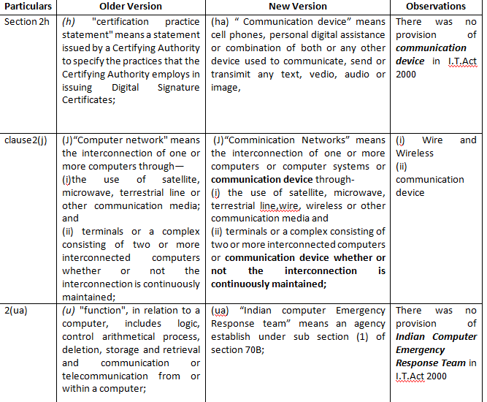
Post 26/11 Attack the changes in the legislation

Slide 19
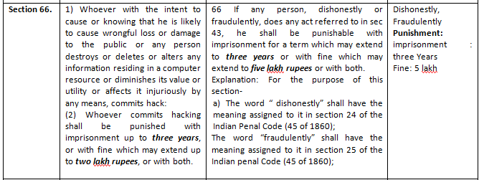
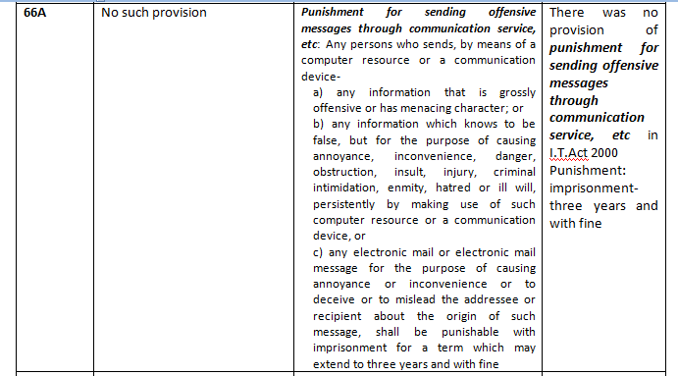

Slide 20
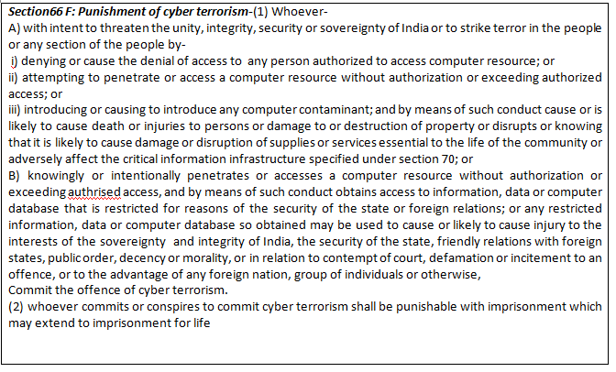

Slide 21
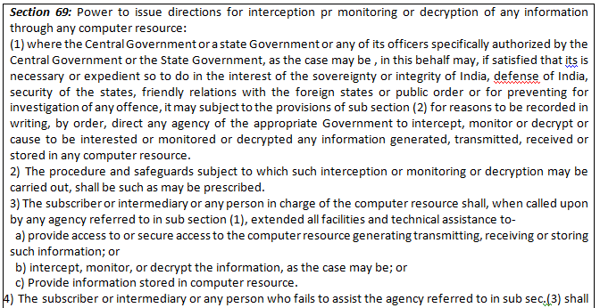

Slide 22
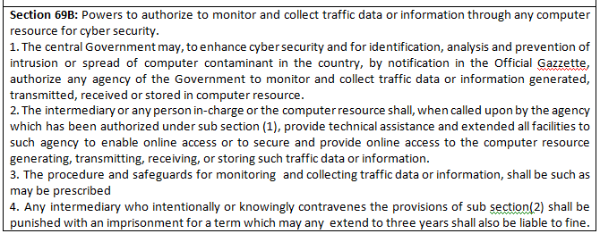

Slide 23
Capacity Development
Information Security and Education and Awareness Program- ISEA.
5 Years
Budget out lay US$
2,00,00,000.
Sponsor Ministry of communication and Information Technology.

Slide 24
Courses been offered
Module 1: Training Techniques for Master Trainers
Module 2: Linux Administration and Scripting Languages
Module 3: Information Security Management Concepts
Module 4: Understanding TCP/IP
Module 5: Threats, Vulnerabilities and Countermeasures
Module 6: Introduction to Cryptography and Security Protocols
Module 7: Perimeter Security
Module 8: Incident Handling and Enterprise Forensics
Module 9: BCP and DRP
Module 10: Security Standards and Models

Slide 25
Thank you

Slide 26
REFERENCE:
www.security-gurus.de/papers/cyberwarfare.pdf
http://www.cert-in.org.in/knowledgebase/annualreport/annualreport08.pdf
www.cert-in.org.in/
http://www.cert-in.org.in/roles.htm
http://isea.gov.in/isea/isea/currentstatus.jsp
http://isea.gov.in/isea/organization/rcdetails.jsp
http://isea.gov.in/isea/organization/pidetails.jsp
http://isea.gov.in/isea/organization/impagencys.jsp
http://www.ccc-rac.in/cybercrime.htm
http://www.slideworld.com/slideshows.aspx/CYBER-SKIRMISHES-ppt-2743472
http://www.mynews.in/News/India_Should_Develop_Cyber_War_Capabilities___N35343.html
www.nasscom.org
http:icmis.iiita.ac.in

