Slide 1
Information Security Overview in the Israeli E-Government
Ministry of Finance – Accountant General
E-government Division
April 2010

Slide 2
General Threat
The E-Government Division holds the main connection between the internet and the government offices.
The internet, as a whole, lacks enforcement and is a source for a wide range of attacks.
Dangerous / Not Focused
Dangerous / Focused
Not Dangerous / Not Focused
Not Dangerous / Focused
Attack on the Government offices.
Human-based attack.
Learning curve.
Attack on numerous websites.
Machine/Human based attack.
Learning curve.
Attack on the Government offices.
Human-based attack.
No Learning curve.
Attack on a one/many websites.
Machine/Human based attack.
No Learning curve.

Slide 3
General Threat
Threats:
Defacement of Government Sites.
Theft/Corruption of Government Data.
Theft of services or money from the Government (E-Commerce)
Identity fraud / theft (E-Forms, PKI Infrastructure)
Forgery of bid results (Online bidding service)
Denial of Service attacks.

Slide 4
Attack Scenarios
Information Warfare / Cyber Terror Scenarios:
Taking control of computers belonging to ministers / computers holding valuable data.
Shutting down / Defacing the Israeli Spokesmenship Internet systems during periods of crisis.
Shutting down critical infrastructure connected to the Internet.
Profit / Self Gain Scenarios:
Taking control of computers holding financial / sensitive data by interested parties (Black market, Mafia, Criminal elements).
Hampering data in financial systems.
Recognition Scenarios:
Publishing “confidential” information from the government for recognition.
Defacement of government sites for recognition.

Slide 5
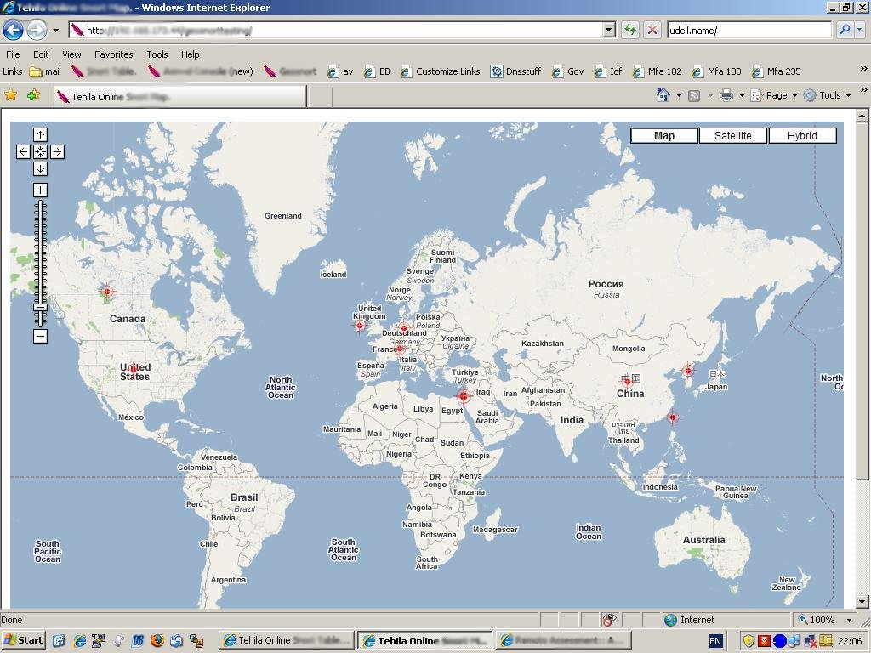
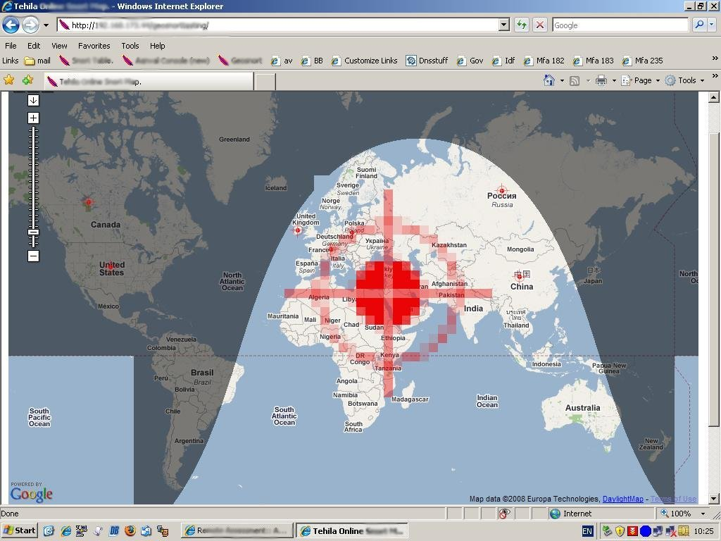
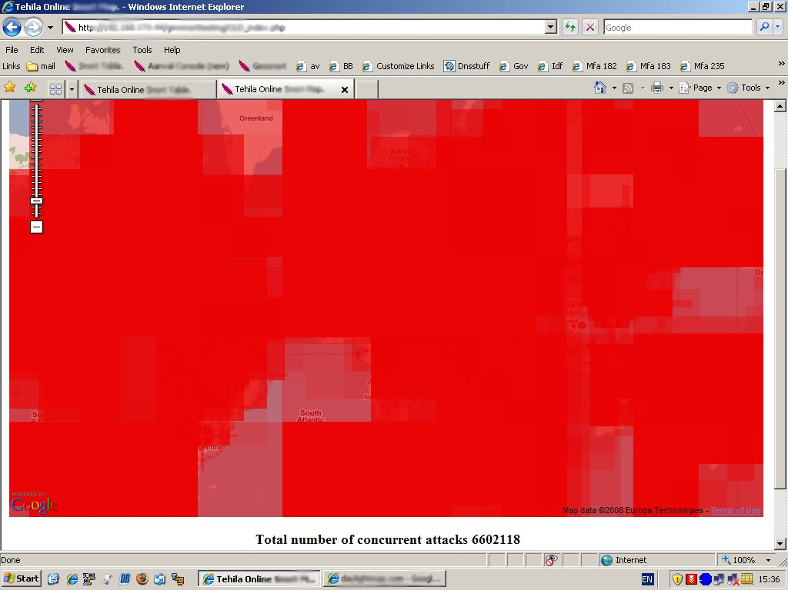

Slide 6
Zeus Infection in the Israeli Government
During 2009, the Security Intelligence Team managed to identify “curious” traffic between the government offices and the Internet.
This traffic was associated with the Trojan horse known as Zeus.
Zeus is considered to be the most spread Trojan today, and is not fully identifiable by Antivirus software.

Slide 7
Zeus Infection in the Israeli Government
Usage of Traffic Monitoring:
.Bin
One dot in domain
.cn
Usage of starvation in order to stop spreading
In the course of about 2 month, the government was clean from Zeus.

Slide 8
“Cyber Jihad”
“Cyber Jihad” is a sub section of Hacktivism, composed of several Muslim hacker groups (most notable are “Team-Evil”).
Generally it encompasses all the Information Warfare activities conducted by Muslim groups against specific centers of attention.

Slide 9
Bank of Israel Defacement
On the 25th of April, 2008, the official site for the Bank of Israel has been defaced.
The site was held in a private Israeli ISP.
The site was ran by the Bank of Israel Spokesperson and not by the Bank of Israel IT.
The E-Government Security Department CERT and Security Intelligence teams researched the breach.
The Attackers have known the exploit in the site for half a year before the beginning of the attack.

Slide 10
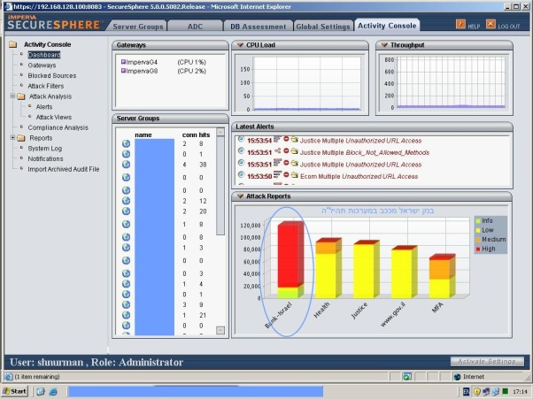
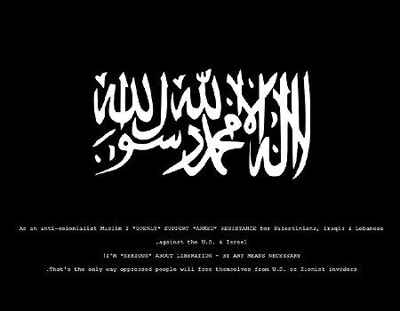
Bank of Israel Defacement - Findings
The attackers have uploaded HTML pages containing the Defacement.
On the 25th of April, the attackers decided to activate the Defacement.
On the 27th of April, the site was moved to the E-Government infrastructure.
On the 30th of April, a coordinated attack containing 250,000 different application attacks started on the Bank of Israel site.

Slide 11
Attacks during Operation “Cast Lead”
Increase of .il sites defacements during the operation.
589 Defacements of .co.il sites.
66 Defacements of .org.il sites.
4 Defacements of .gov.il sites.
2 Defacements of .net.il sites.
Ordinary monthly average.
300 Defacements of .co.il sites.
5 Defacements of .org.il sites.
0 Defacements of .net.il sites (2-3 per year).

Slide 12
Information Security Operations during “Cast Lead”
At the beginning of the operation the SOC (Security Operations Center) was directed to a “loose trigger” policy.
The SOC blocked between 50-100 IPs per shift.
The SOC was reinforced and every shift included between 3-5 SOC operators.
Blocking country-wide IP ranges.

Slide 13
DDoS Attacks against the E-Government Infrastructure during “Cast Lead”
During the Operation there were 4 DDoS attempts at the E-Government Infrastructure.
The attacks were categorized as SYN-Flood attacks, with each attack surpassing it’s predecessor.
At it’s peak, the attacks were generating 15,000,000 connections per second.
In each of the attacks, the E-Government infrastructure was down for a period between 5-20 minutes.
The immediate solution was to activate “Guard” systems in our ISPs.
The Information Security Team managed to pinpoint the tool that was used in the attack and write specific IDS rules for it.
The long term solution includes activating “Guard” systems outside of Israel and improving the ability of the SOC operators to recognize this sort of attack.

Slide 14
Thank you
Ministry of Finance – Accountant General
E-Government Division

